Slide 1
Plant/harvest validation with Matopiba
August 3, 2018

Slide 2
Plant/Harvest date estimation

Slide 3
In GEE: Timeseries Validation w Matopiba v3
Cleaned up the repetitiveness of charting and cleaning data by adding new functions
In GEE: Timeseries Validation w Matopiba v4
Masked out pixels with quarter period outside of 10-70 day range and did analysis for only those pixels (only one or two polygons were taken out because they had nothing within them that had a pixel with ok quarter period

Slide 4
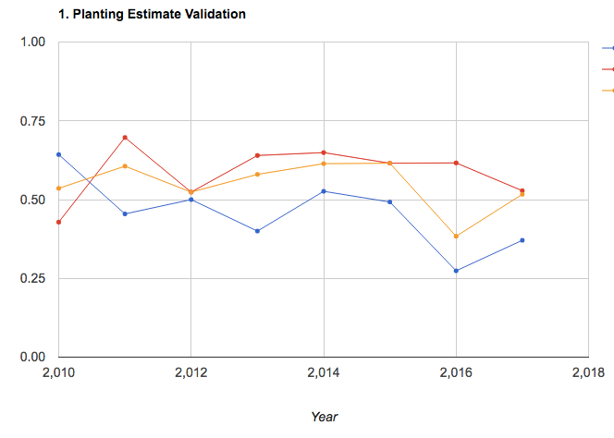
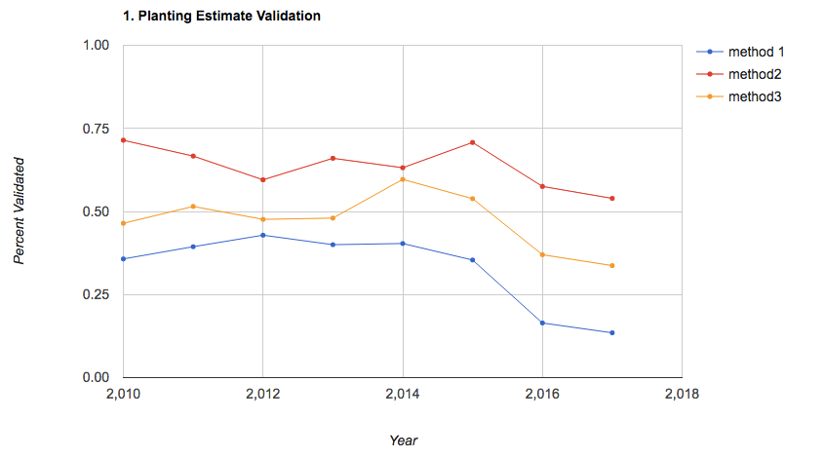
No masking of quarter period, vs masking bad pixels (but not entire polygons based on bad pixels, unless there are NO good pixels in polygon) – done in GEE file Timeseries Validation w Matopiba v4
No masking
Masking of bad pixels
Method 2 had slight improvement

Slide 5
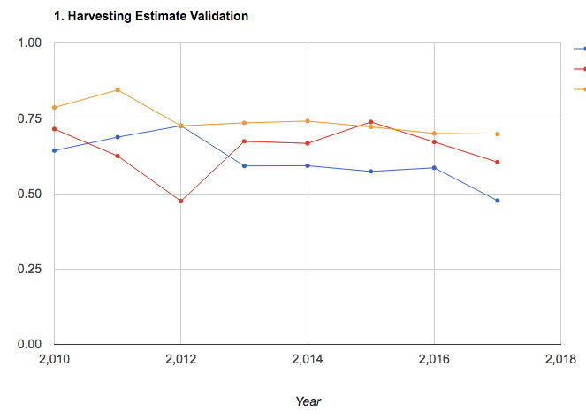
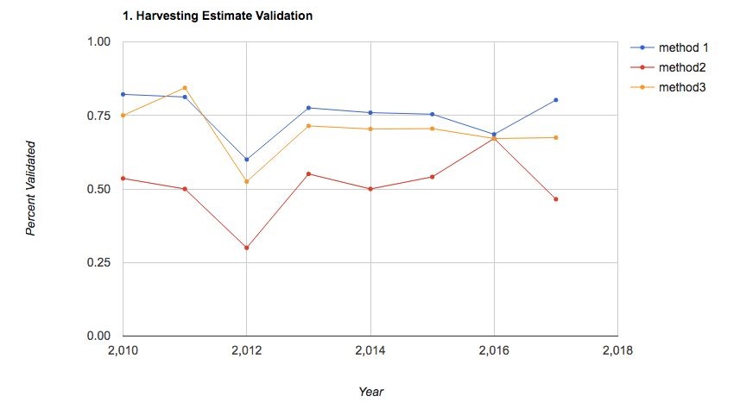
No masking
Masking of bad pixels
The best performing method didn’t really improve

Slide 6
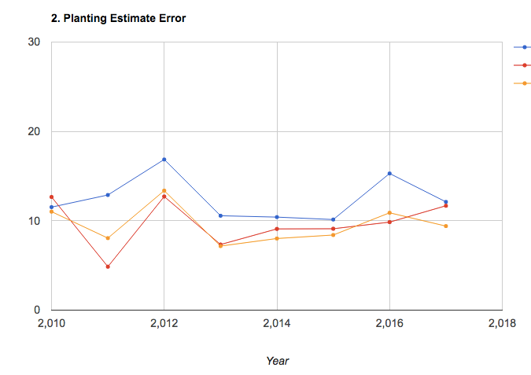
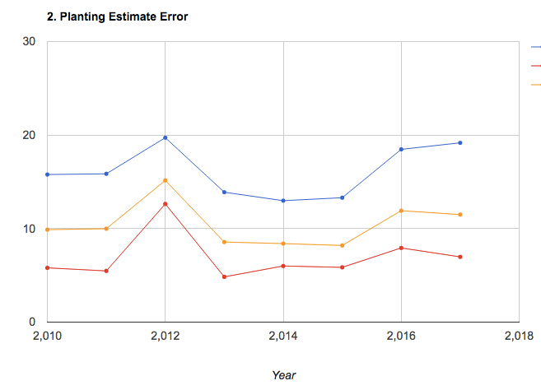
No masking
Masking of bad pixels
Method 2 didn’t improve by much, but there’s a slight improvement

Slide 7
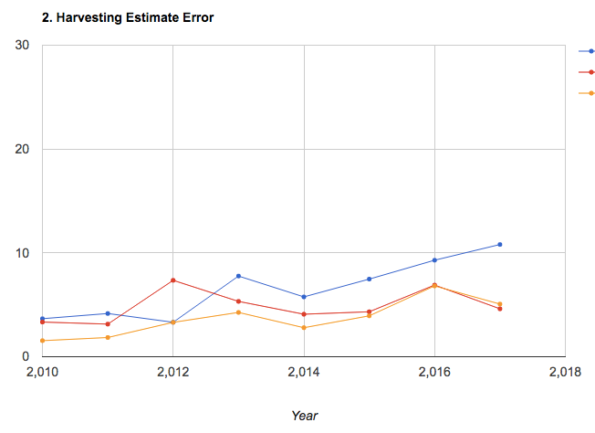
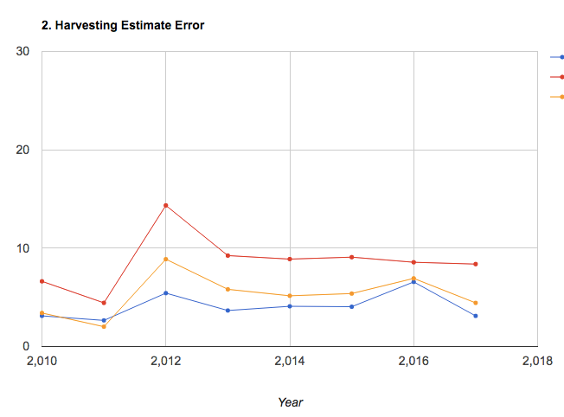
No masking
Masking of bad pixels
In general, method 2 got worse but method 1 bot a lot better.
The best methods perform about the same

Slide 8
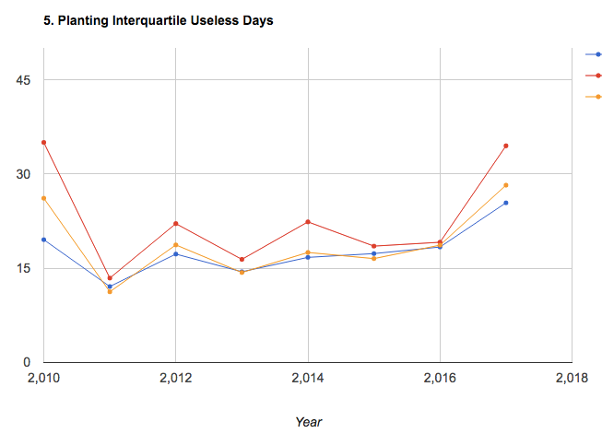
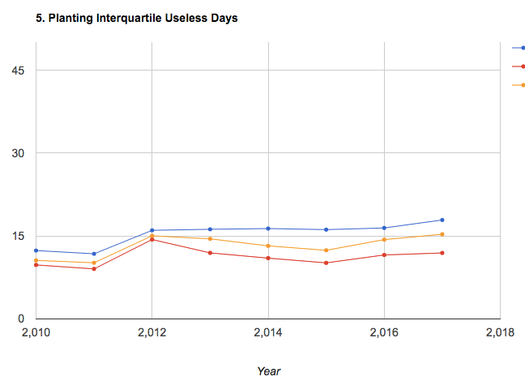
No masking
Masking of bad pixels
Method 2 (red) got a lot better for planting – naturally, because range is smaller (probably)

Slide 9
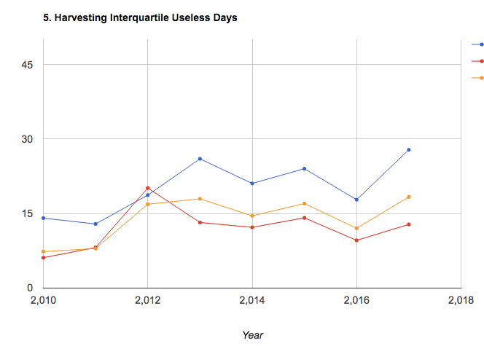
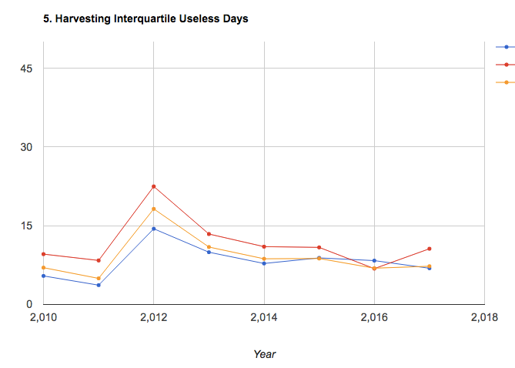
No masking
Masking of bad pixels
Method 1 (blue) got a lot better – in general, useless days decreased

Slide 10
In GEE: Timeseries Validation w Matopiba v5
Put in a chart to look at 0, 25, 50, 75, 100th percentiles of each polygon’s pixel-level estimates and compare that to reported plant/harvest dates
In GEE: Timeseries Validation w Matopiba v6
Add a way to delete an entire polygon from consideration if a certain % of its pixels have bad quarter period estimates
Upon closer inspection of individual pixels (and the patchy nature of bad quarter periods over space), and looking at the matopiba reports of whether a farm has natural vegetation, and the agricultural area vs total area, likely that lots of natural vegetation are biasing our estimates by biasing quarter period.
Conclusion: don’t get rid of polygons with a certain % of bad pixels; because then we’ll be getting rid of most farms. This is because most farms have significant natural vegetation within their bounds. Perhaps it’s a better idea to just get rid of the individual pixels in the polygon.
Found no correlation between % area of bad quarter period pixels and % area of agri pixels in each polygon… why not? Can we have a new measure comparing the overlap between my bad quarter period and Jake’s agri pixels?
Found no correlation between error and percent agricultural area in a polygon… so where is the error coming from? Need to look at specific polygons.
Using only Jake’s agri pixels improved average performance, but not by much, and there are still very extreme errors. Perhaps this indicates errors in Jake’s agri classification, or errors in my peak estimates. Need to look at the specific polygons.
Note: bands in an image don’t have the same mask; need to go for ‘plantDate_1_millis’, etc band to get the mask

Slide 11
Summary of what’s been found for plant/harvest validation this week:
Noticed that getting rid of bad quarter period pixels helped with range performance metrics and a little bit with rmse metric, but still had a lot of points with very significant error (like, 100 days)
Also tried to get rid of entire polygons with a certain % of “bad quarter period pixels”, but most of the polygons would be gotten rid of at even 70% bad pixel threshold, and this discovery led to another…
A lot of the polygons/fields had a lot of natural vegetation, according to Matopiba survey and according to Jake’s land classification – and perhaps my bad quarter period pixels aren’t a good way to separate agri from natural veg pixels
Tested whether bad quarter period pixels correspond to Jake’s natural veg pixels by plotting correlation between their respective percent areas – found some correlation, but not perfect. Perhaps also relate Jake’s agri map to Matopiba reported percent natural vegetation, because Jake’s agri might also have errors.
There was very low correlation between the quality of the estimate and the percent of natural agri from Jake’s map and the percent of bad quarter period pixels
Also tried to only take pixels that are classified as Jake’s agri in order to estimate, and range-related errors are generally better than with taking out bad quarter period pixels alone; but rmse and percent validated didn’t improve – so range is smaller, but central tendency didn’t improve
Even with taking out bad quarter period pixels and only getting Jake’s agri pixels, there are still polygons with significant error. Need to take a close look at them to see what’s going on.

Slide 12
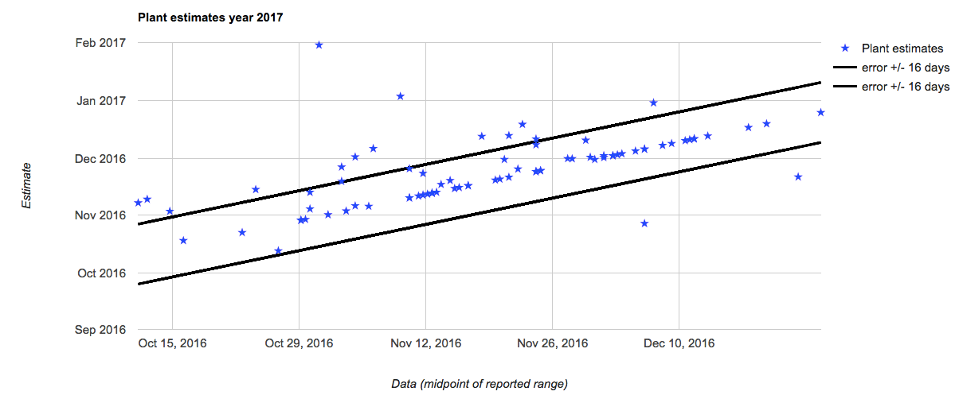
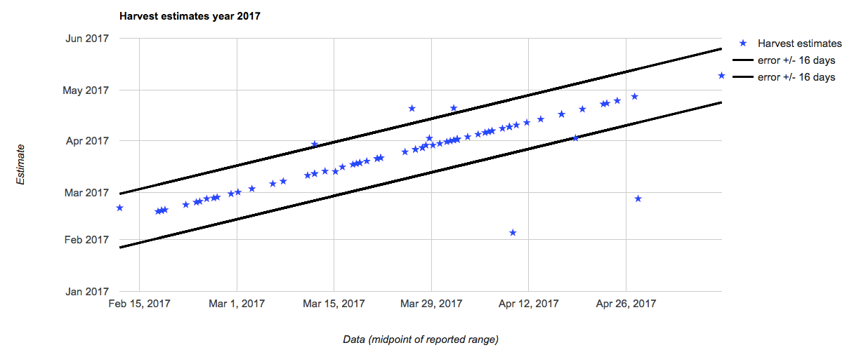
For estimates that are only between 10 – 70 quarter period and Jake’s agri pixels:

Slide 13
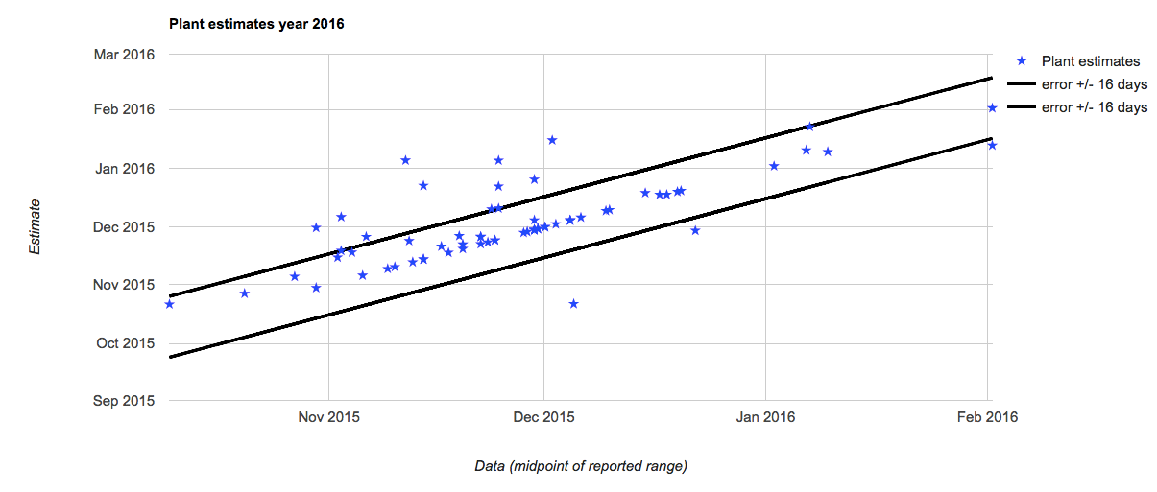
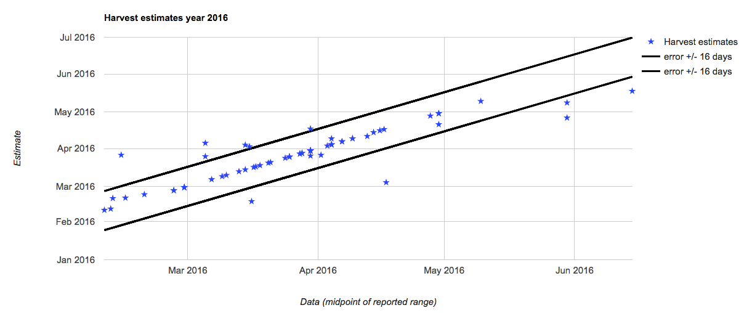
For estimates that are only between 10 – 70 quarter period and Jake’s agri pixels:

Slide 14
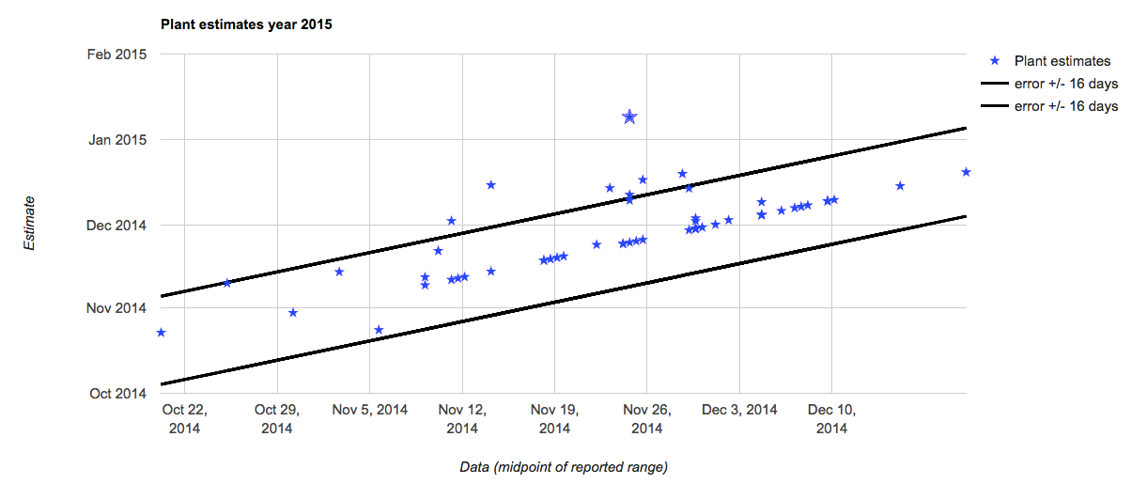
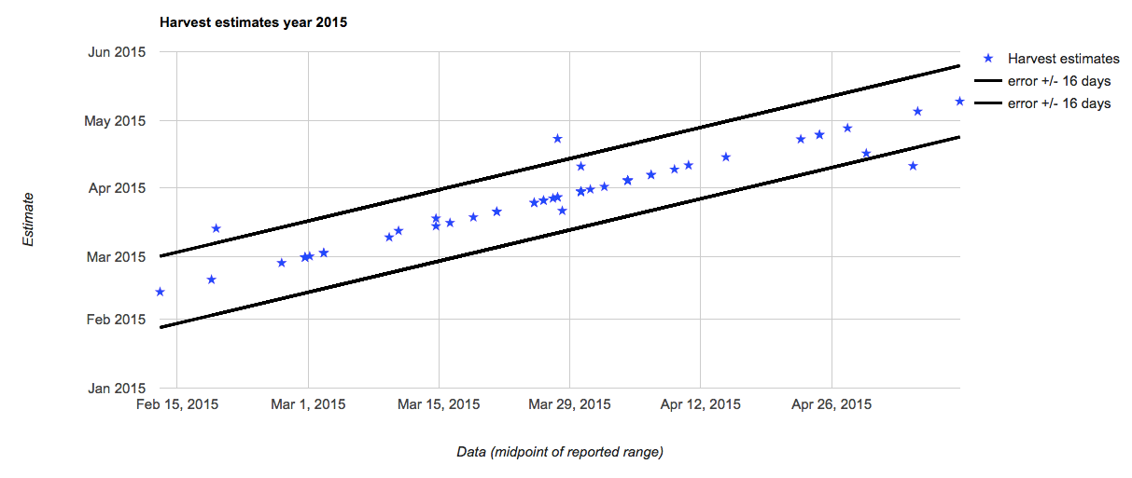
For estimates that are only between 10 – 70 quarter period and Jake’s agri pixels:

Slide 15
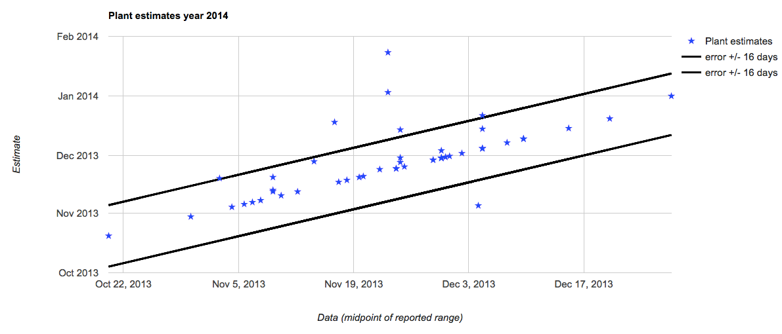
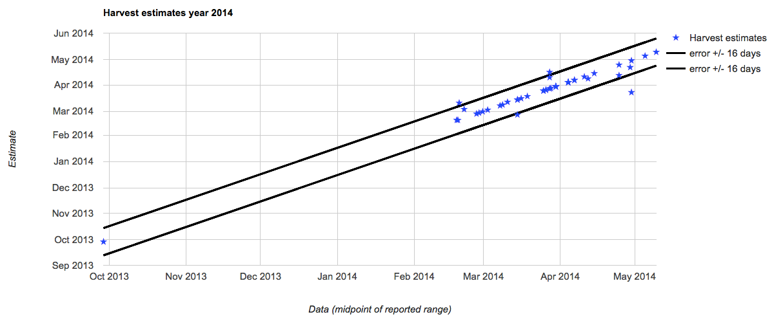
For estimates that are only between 10 – 70 quarter period and Jake’s agri pixels:

Slide 16
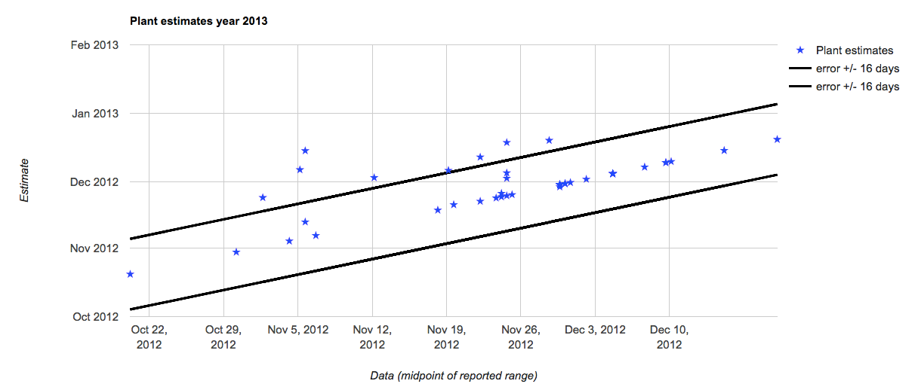
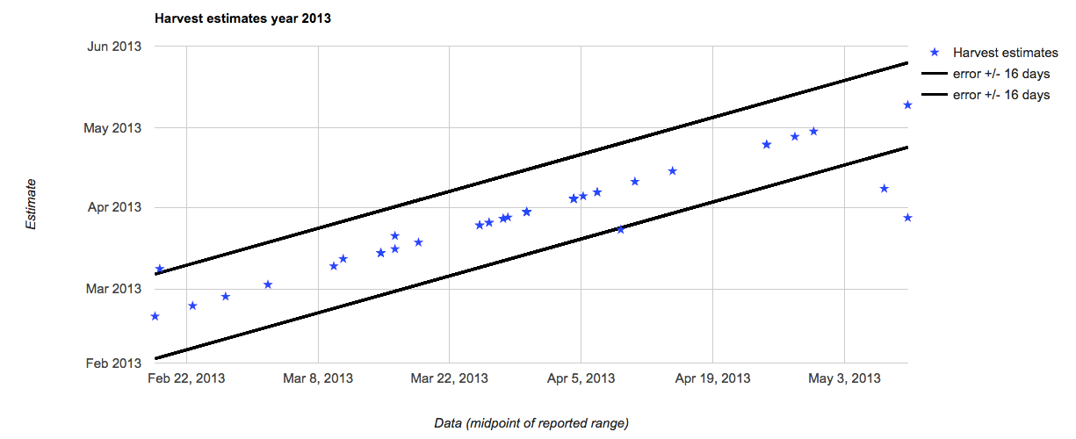
For estimates that are only between 10 – 70 quarter period and Jake’s agri pixels:

Slide 17
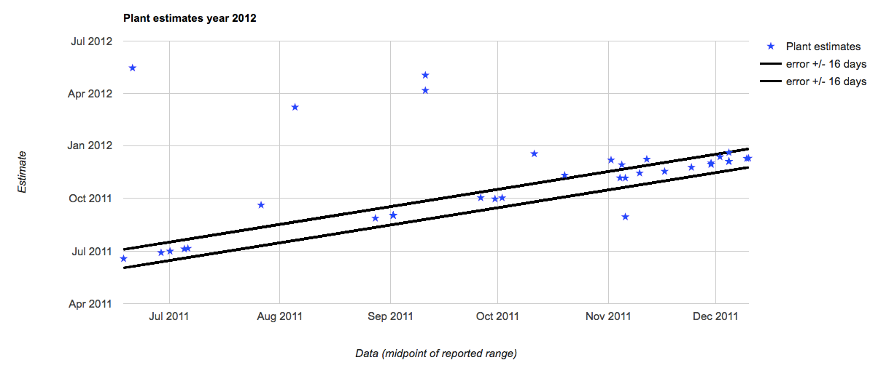
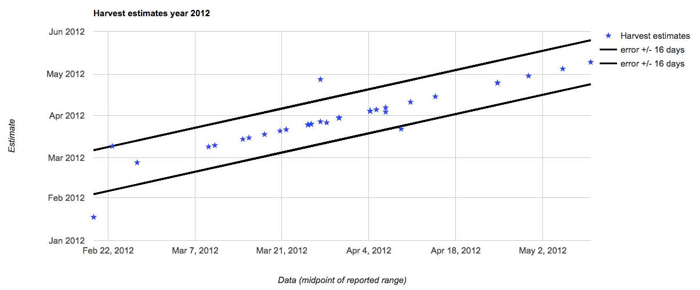
For estimates that are only between 10 – 70 quarter period and Jake’s agri pixels:

Slide 18
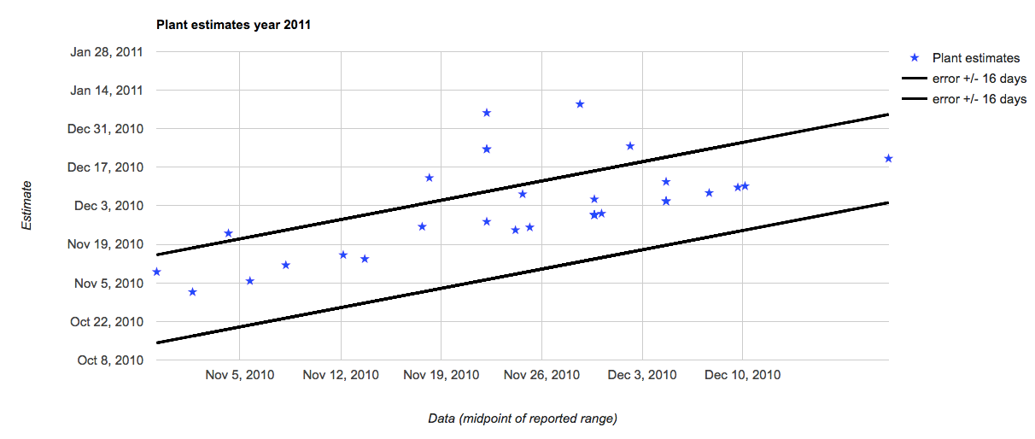
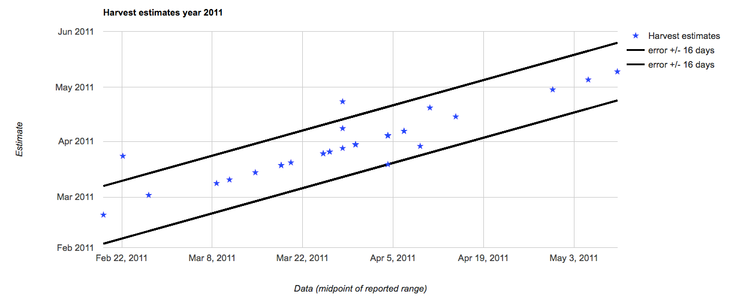
For estimates that are only between 10 – 70 quarter period and Jake’s agri pixels:

Slide 19
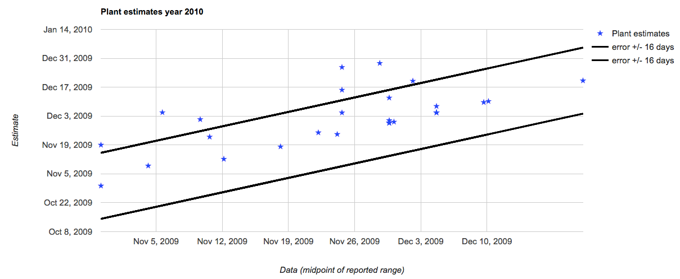
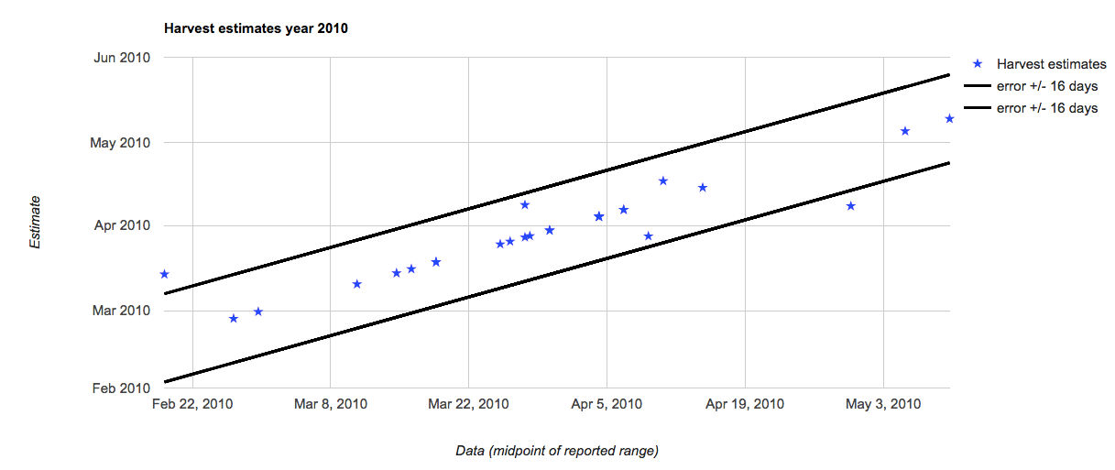
For estimates that are only between 10 – 70 quarter period and Jake’s agri pixels:

Slide 20
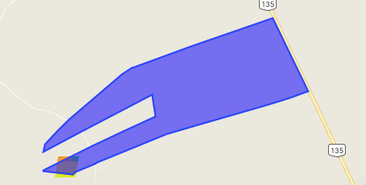
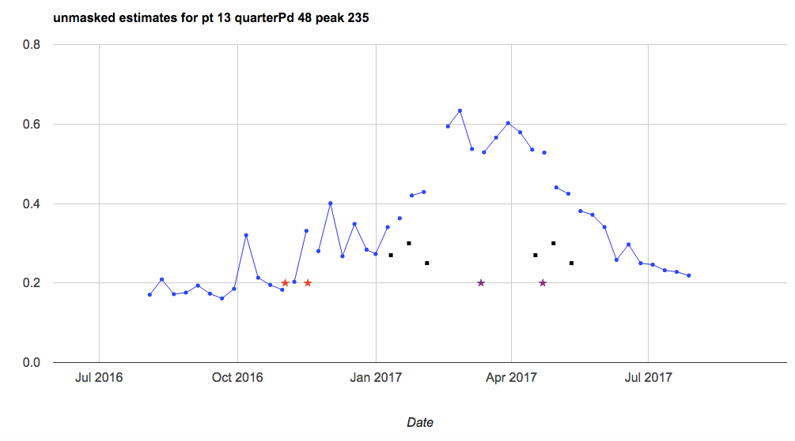
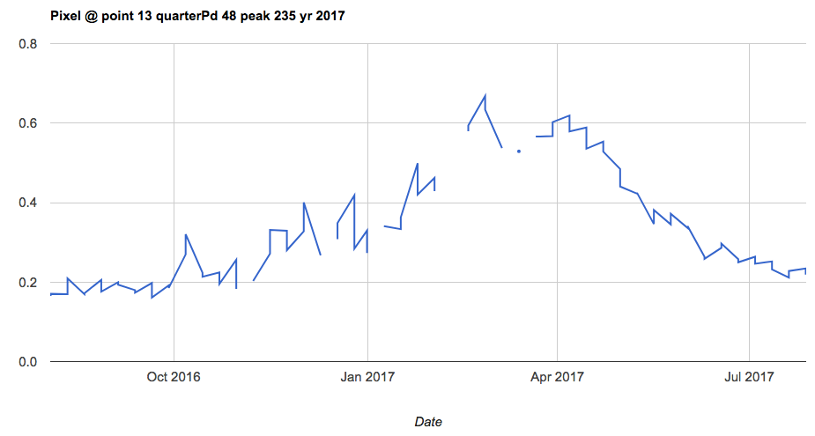
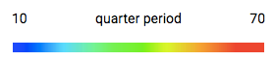
Bad polygon: pt 13, year 2017 (10 – 70 quarter period included, only Jake’s agri included)
Plant error: + 55
Only one pixel… perhaps more is actually agri? Maybe a land use classification issue.

Slide 21
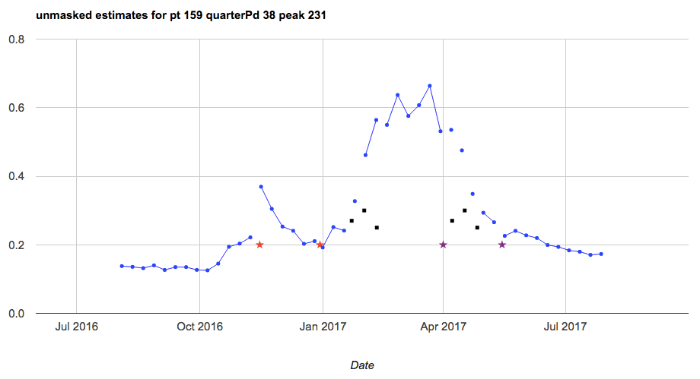
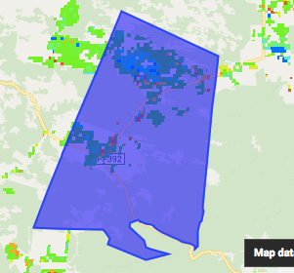
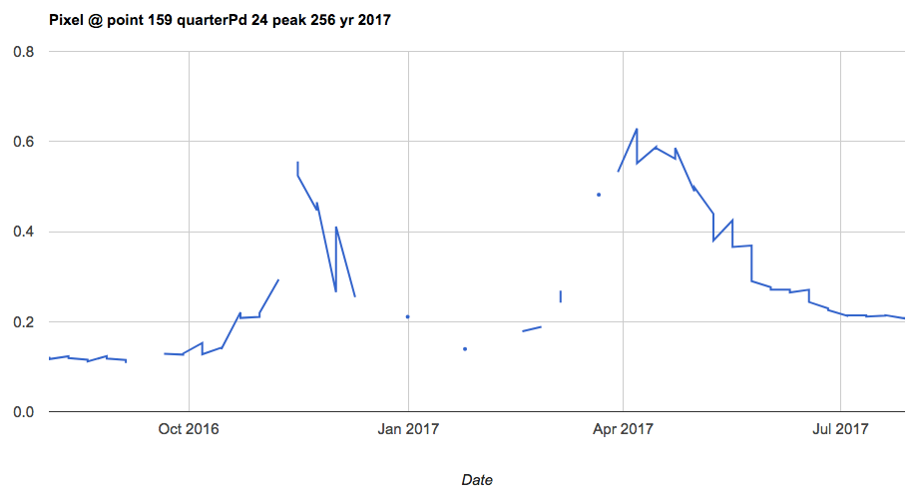
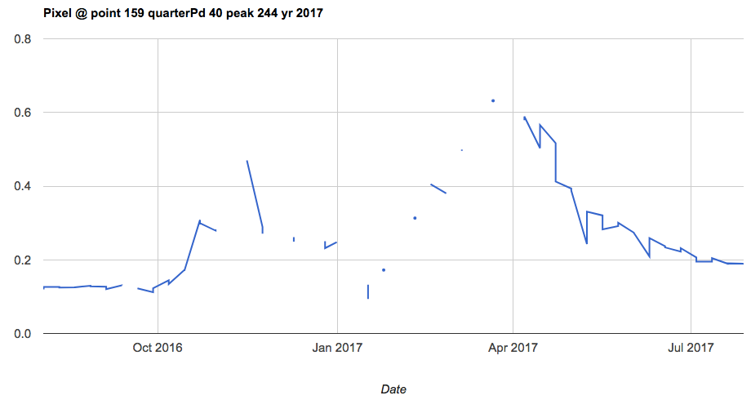
Bad polygon: pt 159, year 2017 (10 – 70 quarter period included, only Jake’s agri included)
Not terrible. Planting came much earlier in the EVI peak than usual.
Plant error: +23

Slide 22
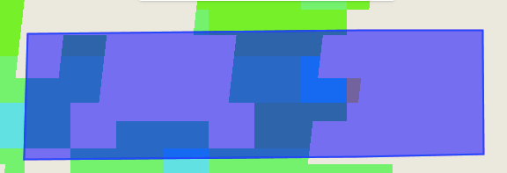
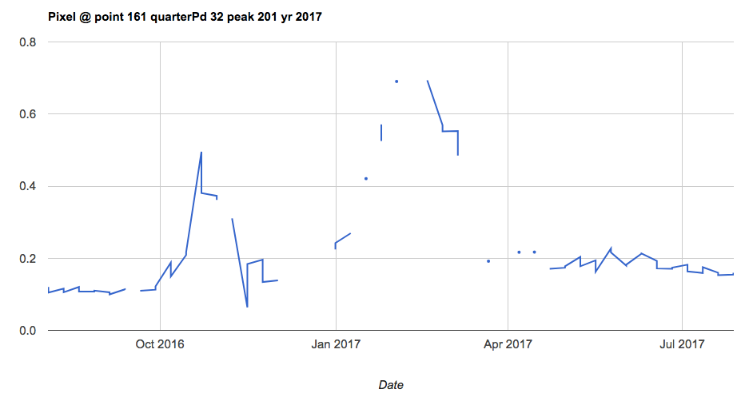
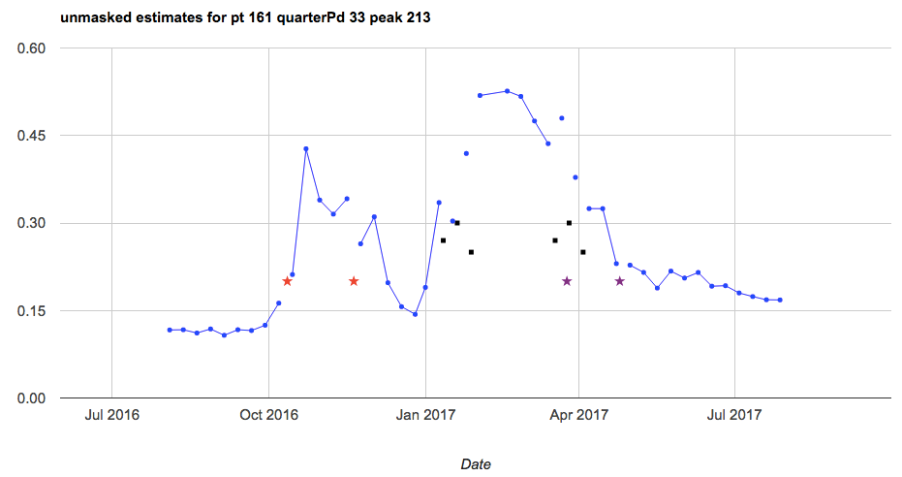
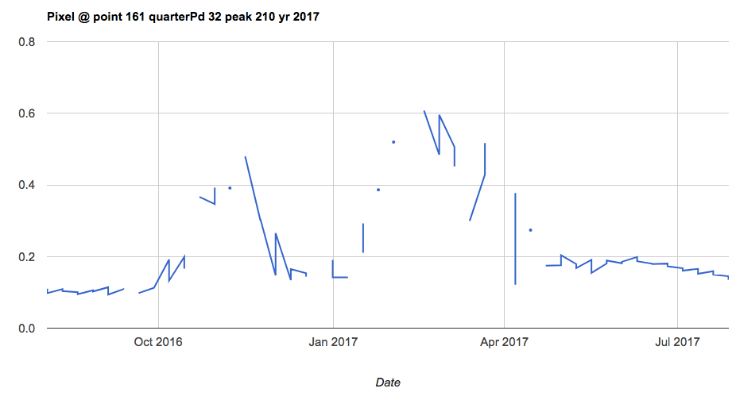
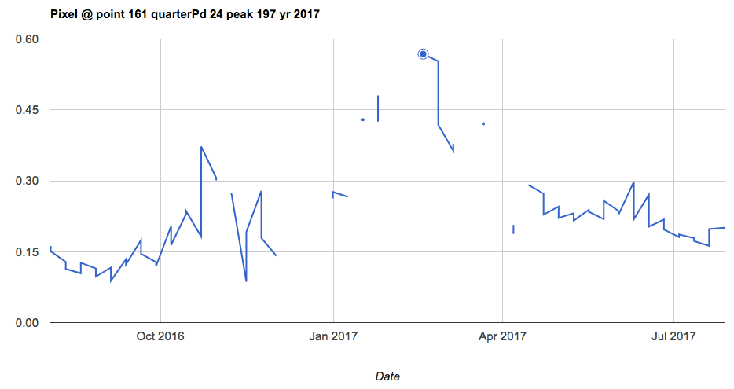
Bad polygon: pt 161, year 2017 (10 – 70 quarter period included, only Jake’s agri included)
Not many pixels to begin with
Planting came much much earlier than expected; perhaps I missed the first crop and instead calculated planting for the second crop… but that doesn’t explain the position of the reported harvest date, which matches with the second crop, and doesn’t explain why planting happened so late in the first peak. Is it a weed peak? Is it a reporting error?
Plant error: +91

Slide 23
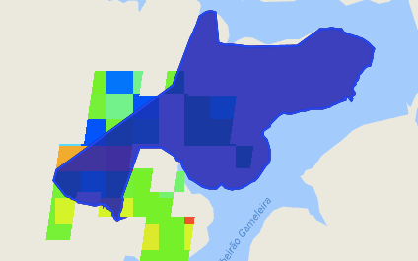
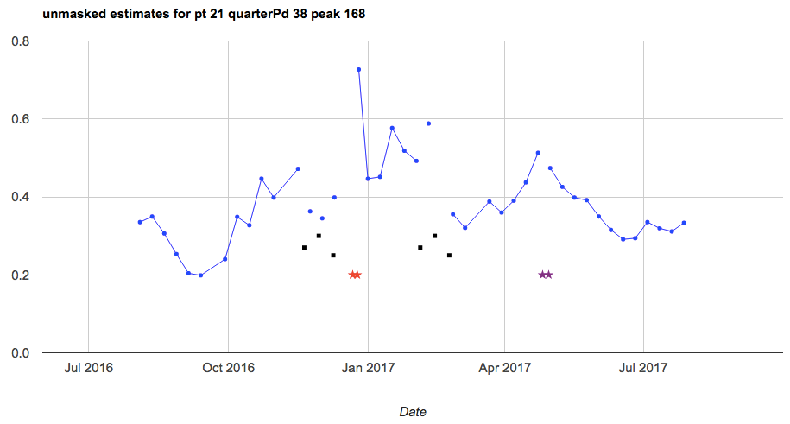
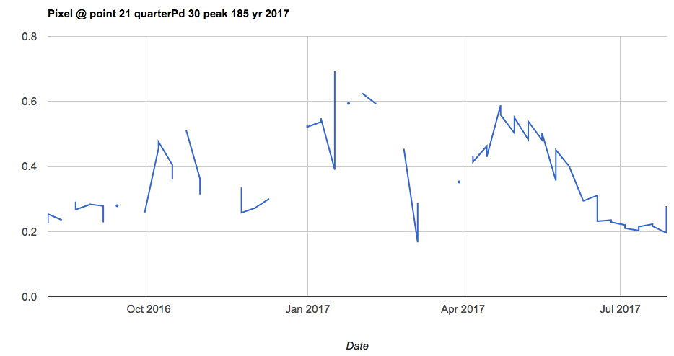
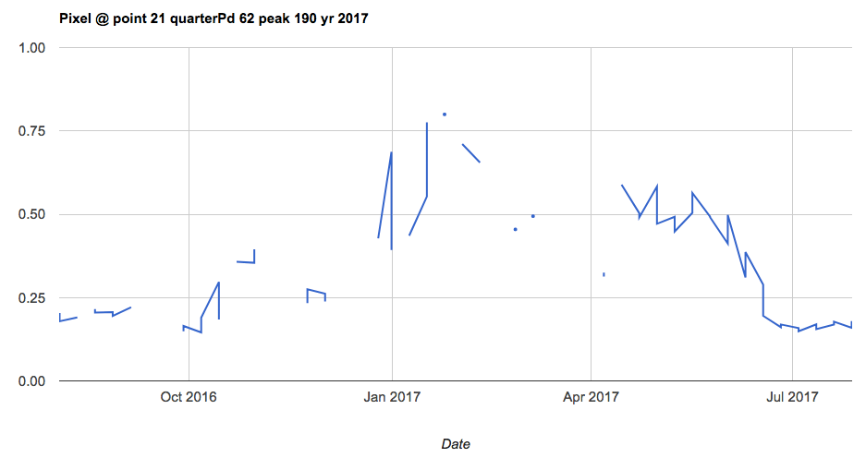
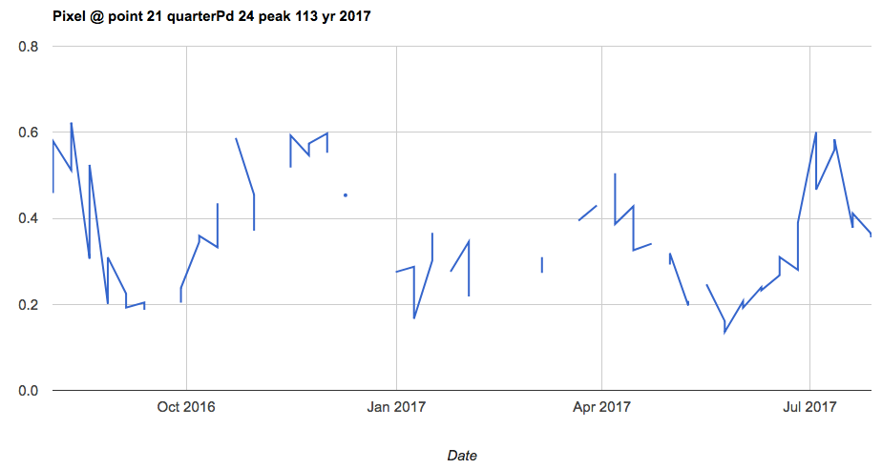
Bad polygon: pt 21, year 2017 (10 – 70 quarter period included, only Jake’s agri included)
Satellite data is pretty bad. Perhaps more RS products would help.
Plant error = -31
Harvest error = -61

Slide 24
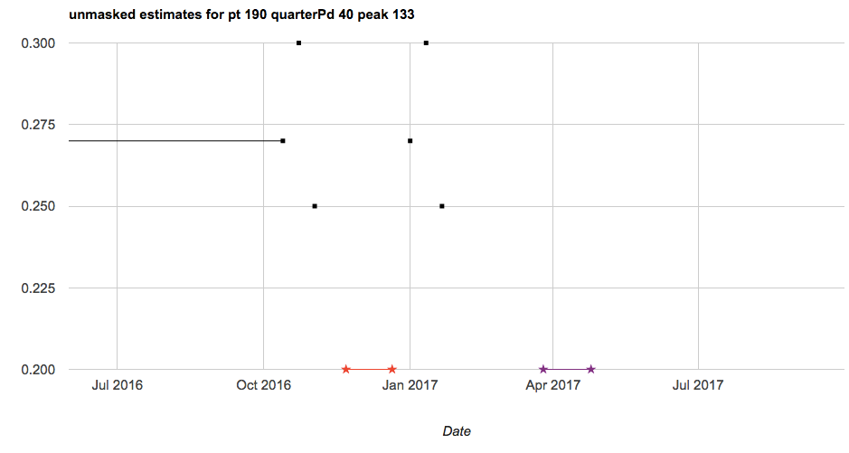
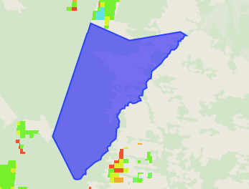
Bad polygon: pt 190, year 2017 (10 – 70 quarter period included, only Jake’s agri included)
There’s nothing in this polygon… how did there be an estimate?
Need to be getting rid of polygons like this…
Plant error = -39
Harvest error = -63

Slide 25
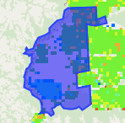
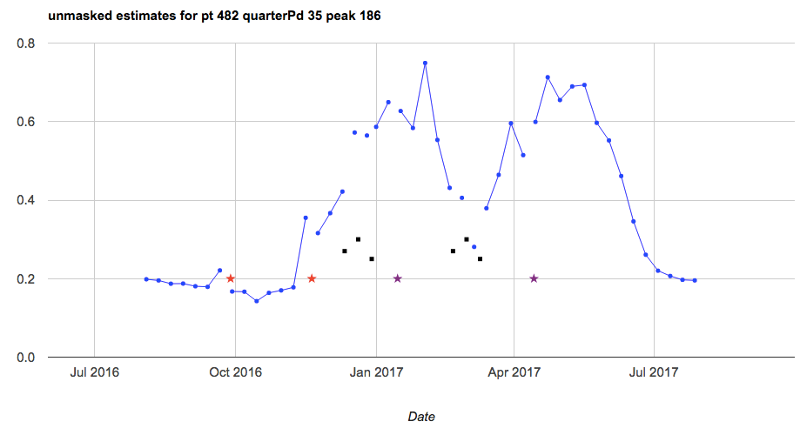


Bad polygon: pt 482, year 2017 (10 – 70 quarter period included, only Jake’s agri included)
Plant error: +21
Plant date is a bit earlier than expected for the EVI curve

Slide 26




Bad polygon: pt 19, year 2017 (10 – 70 quarter period included, only Jake’s agri included)
Plant error: +19
Plant date is a bit earlier than expected given the EVI curve

Slide 27




Bad polygon: pt 151, year 2017 (10 – 70 quarter period included, only Jake’s agri included)
Plant date is way earlier than expected, given EVI. Perhaps this is also an issue with picking out natural vegetation?
Plant error: +27

Slide 28




Bad polygon: pt 155, year 2017 (10 – 70 quarter period included, only Jake’s agri included)
Plant error: +24
Plant date is way earlier than expected, given EVI. Perhaps this is also an issue with picking out natural vegetation?

Slide 29





Bad polygon: pt 490, year 2017 (10 – 70 quarter period included, only Jake’s agri included)
Pixels are weird. There seems to be a lot of shift in location of first peak across the polygon.
Perhaps more RS data would help pin down a dominant first peak location.
Plant error: +27

Slide 30





Bad polygon: pt 479, year 2017 (10 – 70 quarter period included, only Jake’s agri included)
Plant date occurred a bit earlier than expected
Plant error = +14

Slide 31





Bad polygon: pt 481, year 2017 (10 – 70 quarter period included, only Jake’s agri included)
Plant error: +28
Location of first peak shifts a lot. The averaged EVI timeseries makes no sense as a result (but that’s ok because estimates are done on the pixel) – but maybe the shifting causes confusion in averaging stuff out
Plant error = +28

Slide 32




Bad polygon: pt 10, year 2017 (10 – 70 quarter period included, only Jake’s agri included)
Plant and harvest dates occur way earlier than expected given the EVI timeseries – harvest starts at the time of max EVI!
Plant error: +26
Harvest error: +24

Slide 33





Bad polygon: pt 6, year 2017 (10 – 70 quarter period included, only Jake’s agri included)
Planting is earlier and harvest is later than what would be expected given EVI
Plant error: +30
Harvest error: -16

Slide 34




Bad polygon: pt 2, year 2017 (10 – 70 quarter period included, only Jake’s agri included)
Planting is earlier than what would be expected given EVI
Harvest error: +17

Slide 35



Bad polygon: pt 14, year 2017 (10 – 70 quarter period included, only Jake’s agri included)
Harvest error: +7

Slide 36
Summary of common issues with plant/harvest estimates and why they’re bad:
Plant/harvest date were earlier than expected, given shape of EVI curve; maybe issue with land use map or with my estimation method for plant/harvest (i.e. I need to make my plant estimates earlier)
No pixels in polygon but there’s still an estimate somehow… need to get rid of these polygons
Not enough RS data to get a good curve
Reported plant/harvest doesn’t make sense given EVI curve… maybe because of bad land use map or due to reporting error
Very few pixels in the polygon… land use map issue?
Sometimes I mistake the second peak for the first peak
To fix:
New RS data
New land use map
Adjust my plant/harvest
Get rid of empty polygons
Revisit peak/quarter period timing estimation method for different regions?

Slide 37
Summarizing plant/harvest estimates

Slide 38
GEE Code: Crop Dates Statistics and v2
Calculate quantiles of plant, peak, harvest dates for first and second crop over sets of years (2003-2016) and for soy pixels within 25km radius
Reduce regions to get an array of pixel values for each year/polygon combo
Combine the arrays for each polygon over all years to a single array
Reduce the combined array to get percentiles
Note, if a polygon/year doesn’t have any soy points, I replaced that array with an array of [0] – if there are a few years with soy and a few years without, these extra zeros could bias the final quartile result if the years with soy don’t have many pixels.
To generate the multi-year combined array, had to initialize iterate() with a randomly chosen number – this number might affect the final result, but since most areas have at least 5000 soy pixels, probably won’t affect it much.
Need to get these percentiles for “all” soy pixels, but there are too many (can’t export more than 500 or 1000 points at a time), so did random stratified sampling (except only had one class)

Slide 39
TO DO

Slide 40
For plant/harvest validation:
Look at performance of estimates/% of bad pixels in polygon wrt reported total area vs. agricultural area in the survey, and also wrt Jake’s land cover map
look at why certain points are so badly estimated.
Test estimating plant dates earlier since a lot of plant dates are estimated to be later than actual
Start new tester script to compare Jake’s % agri to Matopiba reported % agri – look at their match to see how good the land use map is
Does timing of harvest relative to EVI TS change depending on single/double crop?
Get polygons of natural vs planted area for CAR polys - Included with the raw CAR parcel polygons are a set of polygons containing area in native vegetation. You can find those files in, `/cluster/tufts/cohnlab/brazil_car/data/source/<municipality_code>.zip/VEGETACAO_NATIVA.zip`. The car does not provide information on planted acres, though. That will need to come from somewhere else.
Add on mapbiomas cropland layer in addition to Jake’s map to get cropped areas
Ask: are high error areas close to each other?
Compare discrepancy in errors between single vs double cropped pixels/polygons
Are all pixels within a CAR polygon single vs double cropped, or is there a mixture within a polygon?
Is there correlation between the width of the reported range and the error?
Map the max – min (amplitude) of plant/harvest dates from 2003 to 2016 for a given pixel or region
The polygons never change, but we know productive area changes and you are already using mapbiomas to track those changes. thus, I think a good strategy is to estimate planting dates over a) the intersection of Mapbiomas crop and CAR productive area and b) the intersection of Mapbiomas crop or Mapbiomas crop/pasture and CAR productive area this will be more restrictive than just Mapbiomas. Restinga is sandbank/ephemerally flooded area – mask it out.
Will need to revisit GEE file “Land Use Classification” and continue uploading assets of the CAR polys – stopped after only two out of 42. Then combine each type of land use polygon across all munis and mask out plant/estimate image accordingly.
NEED to propagate error due to incorrect underlying land use.
Pin down how to select for agri pixels (test the land use classification with CAR polygon natural veg poly)
Don’t spend too much more time fine tuning estimations to these methods

Slide 41
For Sally:
Get Srad and precip from Xavier into a table (csv) for the original weather station points for one year (any year)
Get timeseries of Tmin, Tmax and cloudy/clear data flag for each pixel, wait for Avery’s points
Look up triple co-location (adding new satellite data to triangulate plant/harvest estimate)
One key thing is to transition the data cleaning steps to code if you haven’t already. recreate/document the cleaning you already conducted using a code based tool. R would be ideal. This is the best tactics for cleaning data because we it is transparent and allows error tracing

Slide 42
Tests/validation methods for plant/harvest estimates:
From (Urban et al, 2018):
Calculate RMSE, bias, correlation (for interannual variability – R2 and Pearson correlation) and map them to see any spatial patterns in error
Relate bias to season’s avg rain and T, and to fraction natural vegetation to see how error is affected by those factors
Compare estimated plant anomaly (year’s estimated plant date minus average estimated plant date) to actual anomaly. Compare how well anomalies are correlated. And look at how well the estimated spatial pattern of interannual variability matches the spatial pattern of observed variability. Compare boxplots of estimated vs actual anomalies each year
From (Gao et al, 2017):
Can compare a surveyed plant/estimate to RS-based metrics, like peak time and inflection point. There will be a bias, but hopefully also a correlation (see if they follow the same pattern over time and space)
Plot inflection pt or peak vs plant/harvest data (to see whether peak or inflection point has better correlation with data)
Plot year vs DOY for peak, inflection and plant/harvest data over all polygons – essentially peak, inflection, plant data, harvest data will be separate lines on the same plot
Plot polygon vs DOY for peak, inflection and plant/harvest data over all years (or over individual years) – essentially peak, inflection, plant data, harvest data will be separate lines on the same plot

Slide 43



(Sakamoto et al, 2005)
Repeat Fig 4 for growing period (i.e. growing period in data vs growing period in my estimates)
Calculate number of cases (or percent cases) in which estimation error exceeds 16 days
Produce the graphs below
Compare my results to their Table 2

Slide 44
Qual

Slide 45
Form: Higher Degree Committees
Need: exam date
3-5 subject areas (crop modeling, remote sensing, timeseries analysis, causal statistics, land use change)
Committee:
Chair from CEE
ASR (academic senate member) NOT from department
Overall committee must be at least 50% from CEE
Questions about Crop Timing to ask:
How does my estimated peak -> harvest/browndown compare to GDD/thermal time?
For qual, propose the following: (1) plant/harvest date estimation, (2) analyzing plant/harvest date estimation as proxy for farmer behavior over history, (3) something with the statistical crop model.

